Slide 1
Random forest based object detection and classification
Project 2

Slide 2
Main tasks
Image processing and HOG descriptor
Image Classification with Decision Tree and Random Forest
Object Detection with Random Forest
Requirements
Basic C++ programming
OpenCV

Slide 3
Task 1: Image Processing and HOG descriptor
This is a warm-up task to familiarize you with C++ programming and OpenCV library.
Basic data structure in OpenCV to store image data – cv::Mat¹
Basic operations in OpenCV that you need to know
Load and save image – cv::imread, cv::imwrite
Convert imknage to gray scale – cv::cvtColor
Image visualization – cv::imshow
Image rotation – cv::rotate, cv::flip
Image padding – cv::copyMakeBorder
More useful and detailed information can be found in the official tutorial of OpenCV²
1. More detailed information of cv::Mat can be found at: https://docs.opencv.org/4.0.0/d6/d6d/tutorial_mat_the_basic_image_container.html
2. https://docs.opencv.org/4.0.0/d9/df8/tutorial_root.html

Slide 4
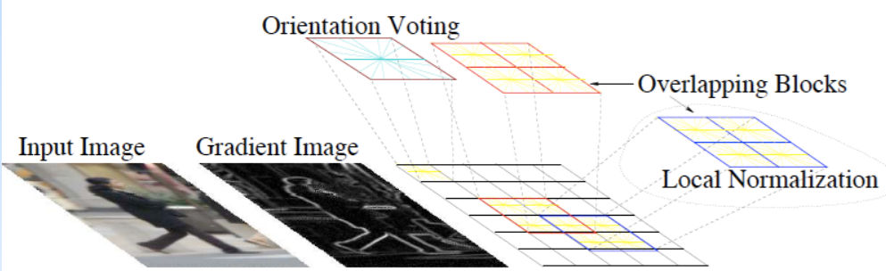
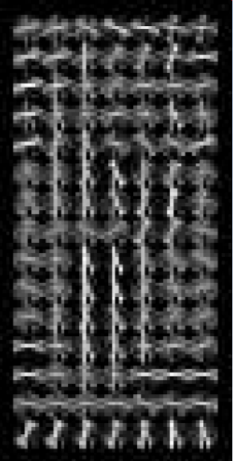
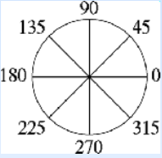
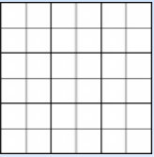
Task 1: Image Processing and HOG descriptor
OpenCV provides a function to compute HOG descriptor -- cv::HOGDescriptor¹
Some public attributes:
cv::Size cellSize
cv::Size blockSize
cv::Size blockStride
cv::Size winSize
For computing HOG descriptors:
void cv::HOGDescriptor::compute
Orientation
Position
1. https://docs.opencv.org/4.0.0/d5/d33/structcv_1_1HOGDescriptor.html

Slide 5
Task 1: Image Processing and HOG descriptor
What you need to do for this task:
Learn how to use OpenCV to load, modify, display and save image
Use the HOGDescriptor class in OpenCV to compute HOG descriptors for images and then visualize
More detailed HOG explanation
https://www.learnopencv.com/histogram-of-oriented-gradients/
https://www.youtube.com/watch?v=0Zib1YEE4LU (slides for the lecture)

Slide 6
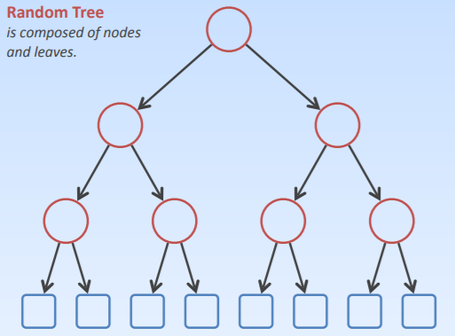
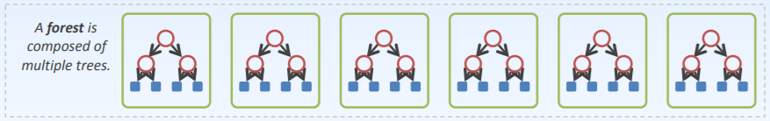
Task 2: Image Classification with Decision Tree and Random Forest
Image classification: given a image, predict its class label
Features to use – HOG desciptors
Classifiers that we’re going to use – Decision Tree and Random Forest
Decision Tree and Random Forest

Slide 7
Task 2: Image Classification with Decision Tree and Random Forest
Binary Decision Tree in OpenCV
Class cv::ml::DTrees¹
Create a decision tree – cv::ml::DTrees.create()
some parameters you may want to change:
void setCVFolds( int val ); // set num cross validation folds
void setMaxCategories( int val ); // set max number of categories
void setMaxDepth( int val ); // set max tree depth
void setMinSampleCount( int val ); // set min sample coun
Train a decision tree – cv::ml::DTrees.train()
Predict class using decision tree – cv::ml::DTrees.predict()
1. https://docs.opencv.org/4.0.0/d8/d89/classcv_1_1ml_1_1DTrees.html

Slide 8
Task 2: Image Classification with Decision Tree and Random Forest
Construct a Forest using Decision Trees
Methods that you need to implement:
create – construct a forest with a given number of trees and initialize all the trees with given parameters
train – train each tree with a random subset of the training data
predict – aggregate predictions from all the trees and vote for the best classification result as well as the confidence (percentage of votes for that winner class)

Slide 9
Task 2: Image Classification with Decision Tree and Random Forest
What you need to do for this task:
Compute HOG descriptors for images and use them as input data for classifiers
Use the class cv::ml::DTrees in OpenCV to train and predict classes of given images
Implement a random forest with decision trees, with the create, train and predict functions
Use the implemented random forest to train and predict classes of given images
Record and compare the classification results between those two methods

Slide 10
Task 3:Object Detection with Random Forest
General steps for object detection:
Generate bounding boxes on image
Use pretrained classifier to classify each bounding boxes
Use NMS to filter out overlapping bounding boxes
Compute precision and recall to evaluate detection result

Slide 11
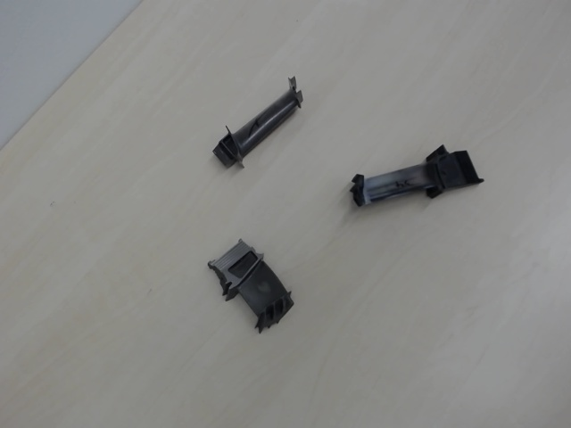
Task 3:Object Detection with Random Forest
Generate bounding boxes on image
Here we use an exhaustive sliding windows to generate bounding boxes on image to classify

Slide 12
Task 3:Object Detection with Random Forest
Use pretrained classifier to classify each bounding boxes
Class 0
Score 0.80

Slide 13
Task 3:Object Detection with Random Forest
Use NMS to filter out overlapping bounding boxes
Rank the predicted object bounding boxes according to its score
Starting with the box with high score, and suppress the other boxes which has a large overlapping ratio with it
Output the rest boxes that are not suppressed

Slide 14
Task 3:Object Detection with Random Forest
Compute precision and recall to evaluate detection result
Compute the IOU (insection over union) ratio with the predicted bounding boxes and ground truth bounding boxes, and use a threshold (~0.5) to verify the prediction is correct / wrong
Precision = # of corrected predicted bounding boxes / # of predicted bounding boxes
Recall = # of corrected predicted bounding boxes / # of ground truth bouding boxes
Adjust the threshold for predicted bounding boxes with a score above the threshold, and get a series of precision/recall, plot the precision/recall curve

Slide 15
Task 3:Object Detection with Random Forest
What you need to do for this task:
Implement a complete pipeline of object detection using HOG descriptors and Random Forest
Report the final precision/recall results on the test dataset

Slide 16
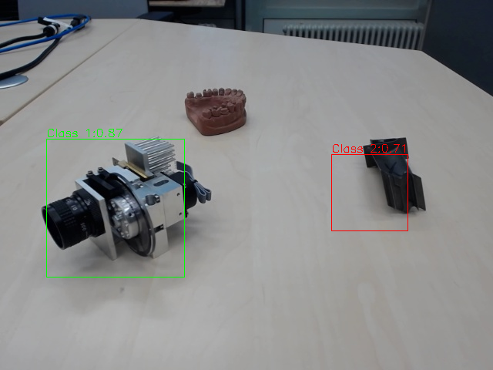
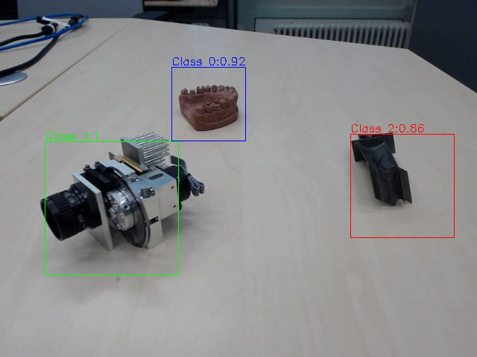
Detector trained without data augmentation
Detector trained with data augmentation

Slide 17
That’s all
Tasks are:
Image processing and HOG descriptor
Image Classification with Decision Tree and Random Forest
Object Detection with Random Forest

